Slide 1
UNIT 5
Branching Control Structures,
Loop-Control Structure, and
Continue and break Statements,
Expressions,
Command Substitution,
Command Line Arguments and
Functions.

Slide 2
Branching Control Structures
Branching control structures allow you to control the flow of execution based on certain conditions. The main branching control structures in shell scripting are:
if-else statements: These statements evaluate a condition and execute one block of code if the condition is true, and another block of code if the condition is false.
case statements: Also known as switch statements in other programming languages, case statements provide multiple conditional branches based on the value of a variable.

Slide 3
Examples
#!/bin/bash
# Example script to check if a number is even or odd
echo "Enter a number:"
read number
if [ $((number % 2)) -eq 0 ]; then
echo "$number is even."
else
echo "$number is odd."
fi
OUTPUT:
Enter a number:
7
7 is odd.

Slide 4
#!/bin/bash
x=5
y=7
z=7.2
[ $x -eq $y ]
echo $?

Slide 5
case variable in
pattern1)
# commands to execute if variable matches pattern1
;;
pattern2)
# commands to execute if variable matches pattern2
;;
pattern3|pattern4)
# commands to execute if variable matches either pattern3 or pattern4
;;
*)
# commands to execute if no patterns match (default case)
;;
esac

Slide 6
Examples
OUTPUT:
Enter a number (1-7):
3
Wednesday
#!/bin/bash
# Example script to determine the day of the week based on a number
echo "Enter a number (1-7):"
read day
case $day in
1)
echo "Monday"
;;
2)
echo "Tuesday"
;;
3)
echo "Wednesday"
;;
4)
echo "Thursday"
;;
5)
echo "Friday"
;;
6)
echo "Saturday"
;;
7)
echo "Sunday"
;;
*)
echo "Invalid input. Please enter a number between 1 and 7."
;;
esac

Slide 7
Loop-Control Structure
Loop-control structures allow you to execute a block of code repeatedly until a certain condition is met. The main loop-control structures in shell scripting are:
for loops: These loops iterate over a sequence of values or elements.
while loops: These loops execute a block of code repeatedly as long as a specified condition is true.
until loops: These loops execute a block of code repeatedly until a specified condition becomes true.

Slide 8
FOR
A for loop construct can be used to execute a set of statements repeatedly as long as a given condition is true.
Here, expr1 contains initialization statement expr2 contains limit test expression expr3 contains updating expression
• Firstly, expr1 is evaluated. It is executed only once.
• Then, expr2 is evaluated to true or false.
• If expr2 is evaluated to false, the control comes out of the loop w/o executing the body of the loop.
• If expr2 is evaluated to true, the body of the loop (i.e. statement1) is executed.
• After executing the body of the loop, expr3 is evaluated.
• Then expr2 is again evaluated to true or false. This cycle continues until expression becomes false.
Syntax:
for(expr1;expr2;expr3)
{
statement1;
}

Slide 9
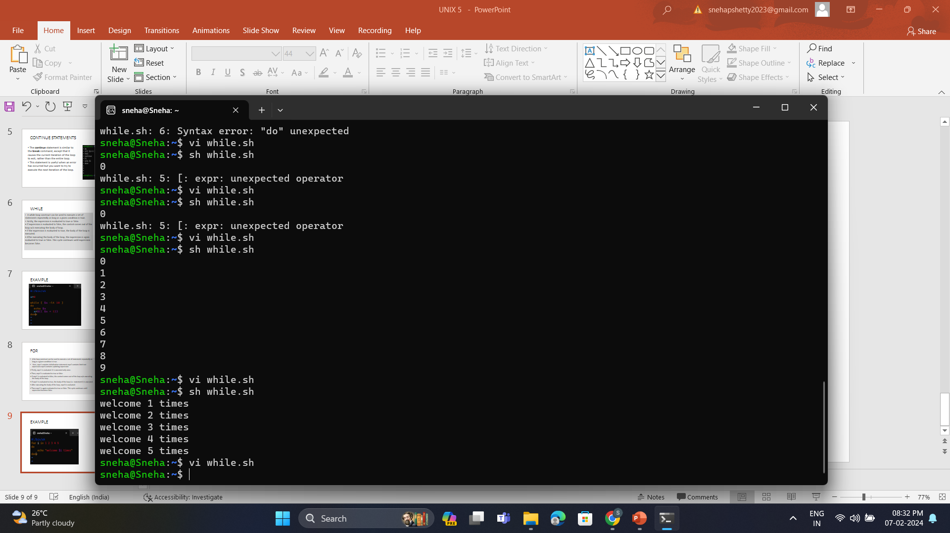
EXAMPLE
OUTPUT
#!/bin/sh
for i in 1 2 3 4 5
do
echo “welcome $i times”
done

Slide 10
Iterate over all files in the current directory
#!/bin/bash
# Iterate over all files in the current directory
for file in *; do
echo "Processing file: $file"
done
OUTPUT:
Processing file: file1.txt
Processing file: file2.txt
Processing file: directory

Slide 11
Nested loop
#!/bin/bash
# Nested loop example
for (( i=1; i<=3; i++ )); do
echo "Outer loop iteration: $i"
for (( j=1; j<=2; j++ )); do
echo "Inner loop iteration: $j"
done
done
OUTPUT:
Outer loop iteration: 1
Inner loop iteration: 1
Inner loop iteration: 2
Outer loop iteration: 2
Inner loop iteration: 1
Inner loop iteration: 2
Outer loop iteration: 3
Inner loop iteration: 1
Inner loop iteration: 2

Slide 12
WHILE
A while loop construct can be used to execute a set of statements repeatedly as long as a given condition is true.
Firstly, the expression is evaluated to true or false.
• If expression is evaluated to false, the control comes out of the loop w/o executing the body of loop.
• If the expression is evaluated to true, the body of the loop is executed.
• After executing the body of the loop, the expression is again evaluated to true or false. This cycle continues until expression becomes false.
SYNTAX:
while (expression)
{
statement1
}

Slide 13
EXAMPLE
OUTPUT
#!/bin/sh
a=0
while [$a –lt 10]
do
echo “$a”
a=$(($a+1))
done
}

Slide 14
Reading user input until a specific condition is met
#!/bin/bash
# Prompt the user to enter a number
echo "Enter a number (0 to exit):"
# Initialize the variable to store user input
number=1
# Execute the loop until the user enters 0
while [ $number -ne 0 ]; do
read -r number
echo "You entered: $number"
done
echo "Exiting the loop."
OUTPUT:
Enter a number (0 to exit):
5
You entered: 5
10
You entered: 10
0
You entered: 0
Exiting the loop.

Slide 15
Generating a Fibonacci sequence
#!/bin/bash
# Prompt the user to enter the length of the Fibonacci sequence
echo "Enter the length of the Fibonacci sequence:“
# Read the user input
read -r length
# Initialize variables for Fibonacci sequence
a=0
b=1
count=1

Slide 16
# Execute the loop to generate the Fibonacci sequence
echo "Fibonacci sequence:“
while [ $count -le $length ]; do
echo -n "$a "
fn=$((a + b))
a=$b
b=$fn
((count++))
Done
echo "" # Print a newline after the sequence
OUTPUT:
Enter the length of the Fibonacci sequence:
8
Fibonacci sequence:
0 1 1 2 3 5 8 13

Slide 17
Until Loop
In an "until" loop, the loop continues executing the code block until the specified condition evaluates to true.
It is essentially the opposite of a "while" loop.
Syntax:
until [ condition ]; do
# Code to be executed as long as the condition is false
done

Slide 18
UNTIL LOOP
#!/bin/bash
counter=0
until [ $counter -eq 5 ]; do
echo "Counter: $counter"
((counter++))
done
echo "Loop finished."
OUTPUT:
Counter: 0
Counter: 1
Counter: 2
Counter: 3
Counter: 4
Loop finished.

Slide 19
Squares using Until Loop
#!/bin/bash
target=10
current=1
until [ $current -ge $target ]; do
echo "Current Value: $current"
((current *= 2))
done
echo "Loop finished."
OUTPUT:
Current Value: 1
Current Value: 2
Current Value: 4
Current Value: 8
Loop finished.

Slide 20
Continue and break Statements
These statements are used within loops to control the flow of execution.
continue: This statement causes the loop to skip the rest of the current iteration and move to the next iteration.
break: This statement causes the loop to terminate immediately, regardless of the loop's condition.

Slide 21
CONTINUE STATEMENTS
The continue statement is similar to the break command, except that it causes the current iteration of the loop to exit, rather than the entire loop.
This statement is useful when an error has occurred but you want to try to execute the next iteration of the loop.
Syntax:
continue [n]
//if n is mentioned then it continues from the nth enclosing loop.

Slide 22
Example
#!/bin/sh
for i in $(seq 1 5)
do
if (($i==3))
then
continue
fi
echo $i
done
OUTPUT:
1
2
4
5

Slide 23
Print even numbers between 1 and 10, skipping odd numbers
#!/bin/bash
echo "Even numbers between 1 and 10:“
for ((i = 1; i <= 10; i++)); do
# Check if the number is odd
if [ $((i % 2)) -ne 0 ]; then
# Skip to the next iteration if the number is odd
continue
fi
# Print the even number
echo "$i"
done
OUTPUT:
Even numbers between 1 and 10:
2
4
6
8
10

Slide 24
BREAK STATEMENT
The break statement is used to terminate the execution of the entire loop, after completing the execution of all of the lines of code up to the break statement.
It then steps down to the code following the end of the loop.
Syntax:
break [n]
// n is number of nested loops .
// By default the value of n is 1.

Slide 25
Example
#!/bin/sh
for i in $(seq 1 10)
do
if (($i==5))
then
break
fi
echo $i
done
OUTPUT:
1
2
3
4

Slide 26
Find the first negative number in a list of numbers
#!/bin/bash
echo "Finding the first negative number in the list:"
numbers=(5 10 -3 8 -6 2 4)
for num in "${numbers[@]}"; do
# Check if the number is negative
if [ $num -lt 0 ]; then
# Print the first negative number and exit the loop
echo "The first negative number is: $num"
break
fi
done
OUTPUT:
Finding the first negative number in the list:
The first negative number is: -3

Slide 27
Expressions
Expressions in shell scripting are combinations of operators, variables, and values that evaluate to a single value.
They are commonly used in conditions and assignments.

Slide 28
Arithmetic Expressions
#!/bin/bash
result=$((10 + 5 * 2))
echo "Result of arithmetic expression: $result"
OUTPUT:
Result of arithmetic expression: 20

Slide 29
String Concatenation
#!/bin/bash
greeting="Hello"
name="John“
message="$greeting, $name!"
echo "$message"
OUTPUT:
Hello, John!

Slide 30
Comparison Expressions
#!/bin/bash
value1=10
value2=20
if [ $value1 -eq $value2 ]; then
echo "Values are equal"
else
echo "Values are not equal"
fi
OUTPUT:
Values are not equal

Slide 31
Logical Expressions
#!/bin/bash
age=25
if [ $age -ge 18 ] && [ $age -lt 60 ]; then
echo "You are an adult"
else
echo "You are not an adult"
fi
OUTPUT:
You are an adult

Slide 32
Command Substitution
Command substitution allows you to use the output of a command as part of another command or expression.
It can be done using backticks (`) or the $() syntax.

Slide 33
Basic Command Substitution
#!/bin/bash
current_date=$(date)
echo "Current date and time: $current_date"
OUTPUT:
Current date and time: <current_date_and_time>

Slide 34
Using Command Output in a Loop
#!/bin/bash
echo "Files in the current directory:"
for file in $(ls); do
echo "$file"
done
OUTPUT:
Files in the current directory:
file1.txt
file2.txt
directory

Slide 35
Command Substitution in Arithmetic Expression
#!/bin/bash
total_files=$(ls | wc -l)
echo "Total number of files in the current directory: $total_files"
OUTPUT:
Total number of files in the current directory: <number_of_files>

Slide 36
Command Line Arguments
Command line arguments are values provided to a script or program when it is executed from the command line.
They can be accessed within the script using special variables like $1, $2, etc., which represent the first, second, and subsequent arguments passed to the script.

Slide 37
Basic Command Line Argument
#!/bin/bash
echo "First argument: $1"
OUTPUT:
./script.sh hello
First argument: hello

Slide 38
Multiple Command Line Arguments
#!/bin/bash
echo "First argument: $1"
echo "Second argument: $2"
echo "Third argument: $3"
OUTPUT:
./script.sh hello world 123
First argument: hello
Second argument: world
Third argument: 123

Slide 39
Using Command Line Arguments in a Loop
#!/bin/bash
echo "Command line arguments:“
for arg in "$@"; do
echo "$arg"
done
OUTPUT:
./script.sh one two three
Command line arguments:
one
two
three

Slide 40
Arithmetic Operation with Command Line Arguments
#!/bin/bash
result=$(( $1 + $2 ))
echo "Sum of $1 and $2 is: $result"
OUTPUT:
./script.sh 5 10
Sum of 5 and 10 is: 15

Slide 41
Functions
Functions in shell scripting allow you to encapsulate blocks of code for reuse.
They are defined using the function keyword or by simply declaring them with their names followed by parentheses.
Functions can take arguments and return values.

Slide 42
Basic Function
#!/bin/bash
greet() {
echo "Hello, World!"
}
# Call the function
greet
OUTPUT:
Hello, World!

Slide 43
Function with Parameters
#!/bin/bash
greet() {
echo "Hello, $1!"
}
# Call the function with an argument
greet "John"
OUTPUT:
Hello, John!

Slide 44
Function with Return Value
#!/bin/bash
add() {
result=$(( $1 + $2 ))
echo $result
}
# Call the function and store the result in a variable
sum=$(add 5 10)
echo "Sum: $sum"
OUTPUT:
Sum: 15

Slide 45
Function with Local Variables
#!/bin/bash
calculate() {
local a=5
local b=10
local result=$(( a * b ))
echo "Result inside function: $result"
}
# Call the function
calculate
OUTPUT:
Result inside function: 50

Slide 46
Function Calling Another Function
#!/bin/bash
say_hello() {
echo "Hello!"
}
say_goodbye() {
echo "Goodbye!"
}
greet() {
say_hello
say_goodbye
}
# Call the parent function
greet
OUTPUT:
Hello!
Goodbye!

Slide 47
Function with Default Parameter
#!/bin/bash
greet() {
name=${1:-"World"}
echo "Hello, $name!"
}
# Call the function with and without argument
greet
greet "John"
OUTPUT:
Hello, World!
Hello, John!

Slide 48
Function Returning Multiple Values
#!/bin/bash
get_system_info() {
os=$(uname -s)
kernel=$(uname -r)
echo "$os $kernel"
}
# Call the function and store the result in variables
info=$(get_system_info)
echo "System information: $info"
OUTPUT:
System information: Linux 5.4.0-91-generic

Slide 49
Function with Error Handling
#!/bin/bash
divide() {
if [ $2 -eq 0 ]; then
echo "Error: Division by zero"
exit 1
fi
result=$(( $1 / $2 ))
echo "Result: $result"
}
# Call the function with different arguments
divide 10 2
divide 10 0
OUTPUT:
Result: 5
Error: Division by zero

Slide 50
Practice Programs
Write a shell script that uses a for loop to print the multiplication table of a given number.
Create a script that iterates over a list of cities and prints a welcome message for each city.
Create a script that prompts the user for three numbers and prints their average using a for loop.
Write a shell script that displays the calendar for each month of a given year using a for loop.
Create a script that generates a random password of a specified length using a for loop.
Write a shell script that calculates the sum of digits of a given number using a while loop.
Create a script that reads numbers from the user until a negative number is entered, then calculates and prints their sum.

Slide 51
THANK YOU

